Slide 1
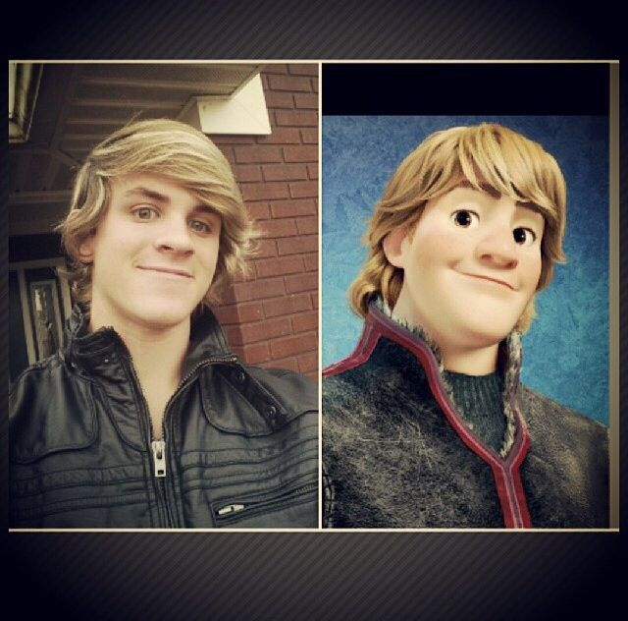
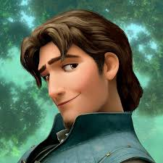
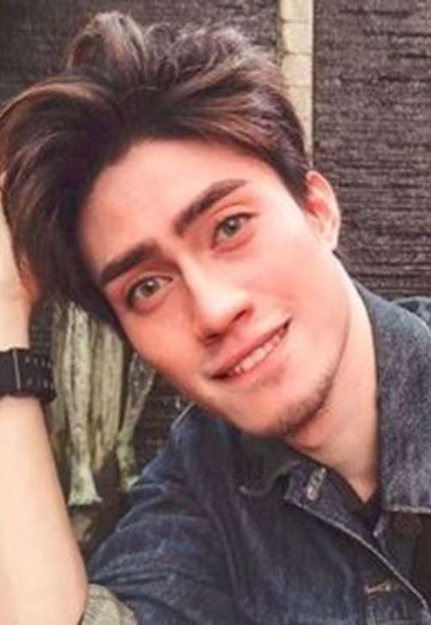
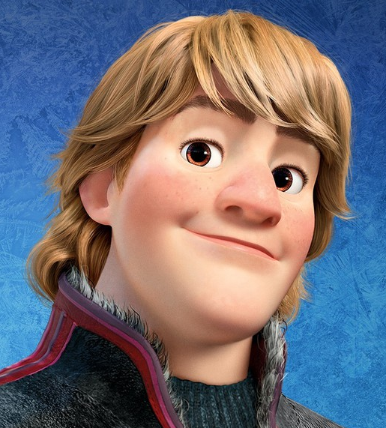
Doppelganger Cartoon

Slide 2
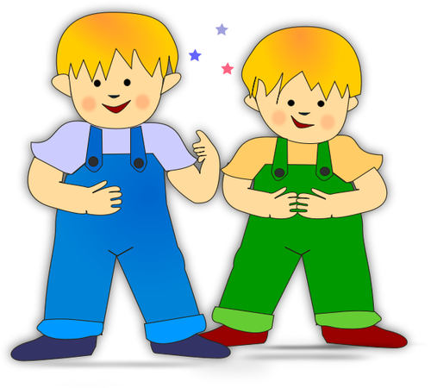
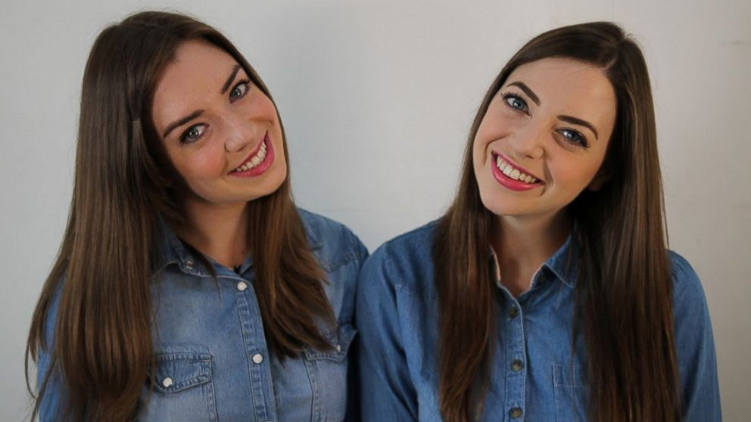
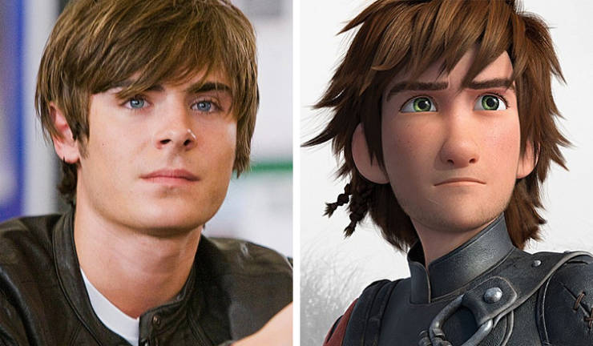
“Apparently, there is a one in 135 chance that there’s a single pair of complete doppelgängers.”
- University of Adelaide biologist Teghan Lucas and team-
‹#›

Slide 3
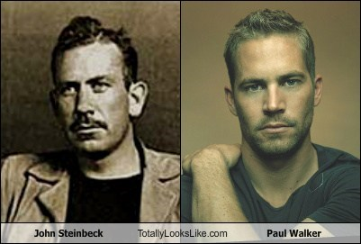
Background & Problem
Doppelganger ?
Twin-stranger , Celebrity look-alike, facebook OMG
Why doppelganger cartoon ?
More researches on face recognition & face detection→Human-Human doppelgangers
Human - Cartoon Doppelganger
Different types of cartoons
Disney cartoons, Caricature cartoons
‹#›

Slide 4
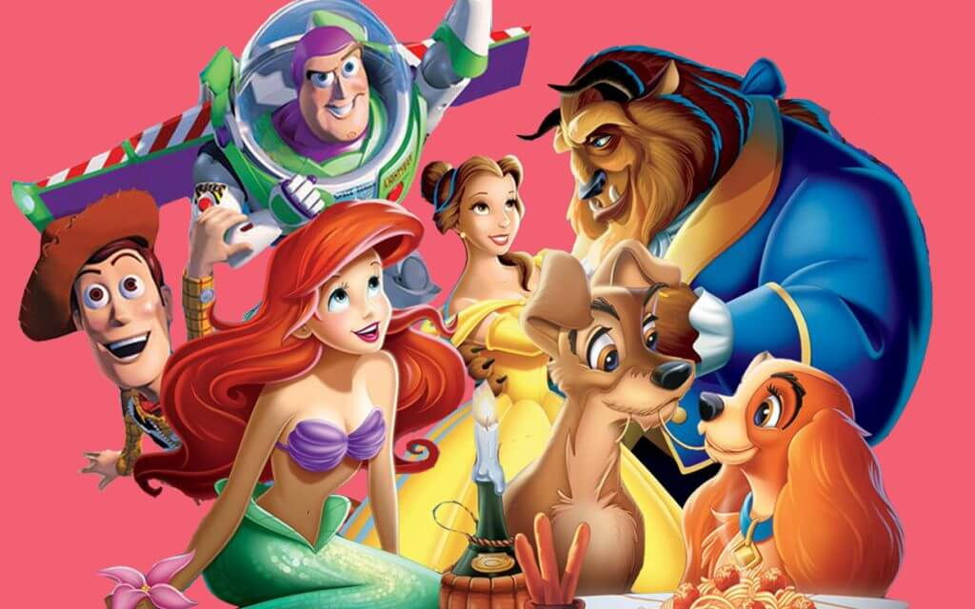
Goal
Create a machine learning algorithm that can find the cartoon character that best looks like the uploaded photo
‹#›

Slide 5
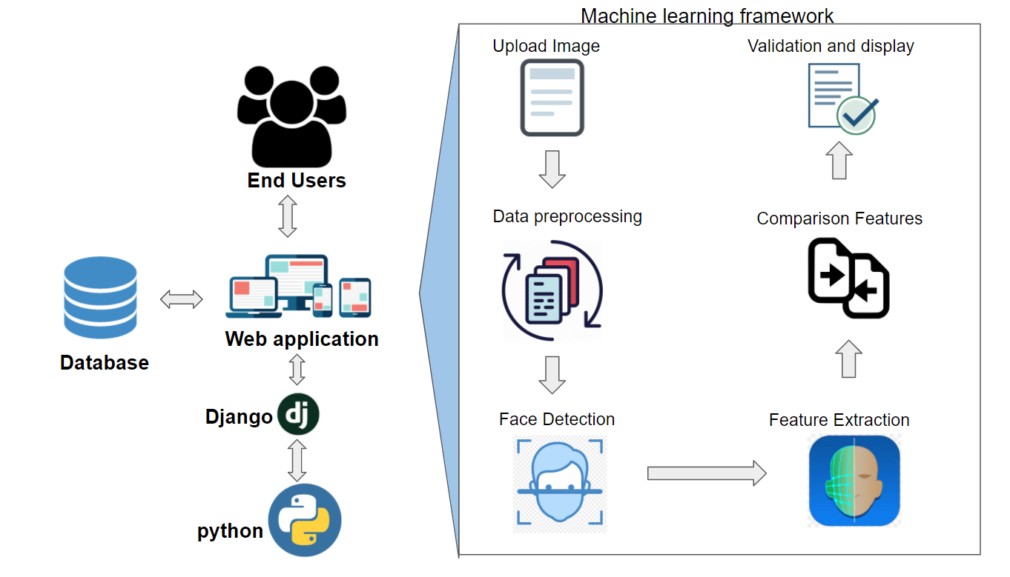
Overall Framework
‹#›

Slide 6






Tools and Techniques
Model
Web application
Version Control

Slide 7
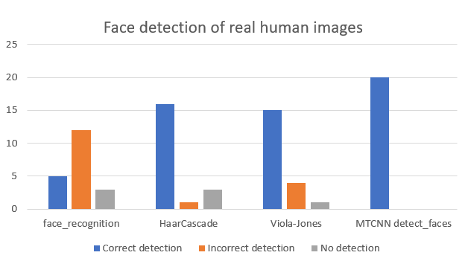
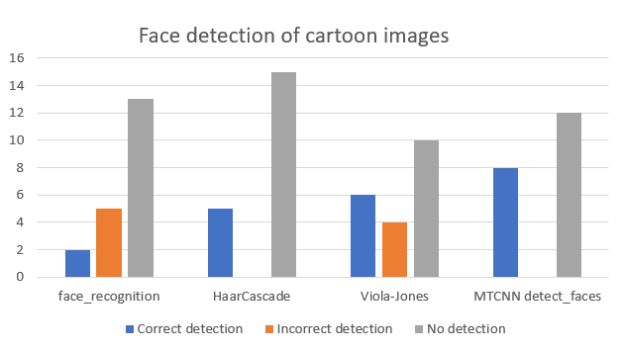
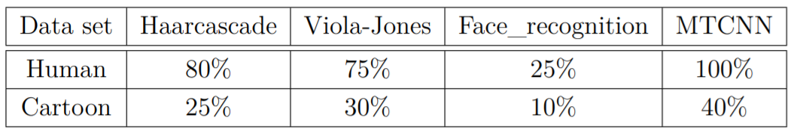
Approach 1(CO 421)
Background search
Pre-trained model based
Face detection
Feature extraction
Comparison
Euclidean distance

Slide 8

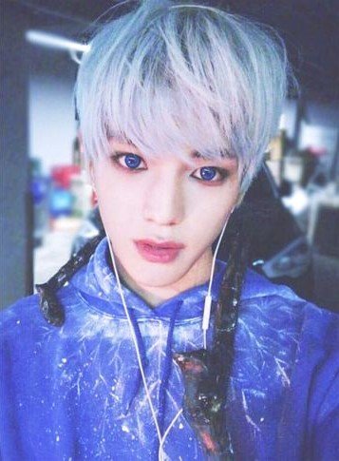
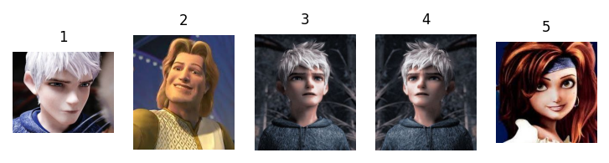
Conclusion after Approach 1
Low performance on face detection of cartoon characters using pretrained models
Create the cartoon repository using only Disney characters
Using the landmarks based comparison
Training landmark models for custom datasets

Slide 9
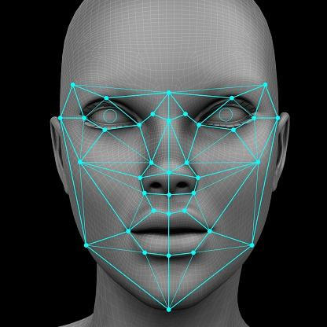
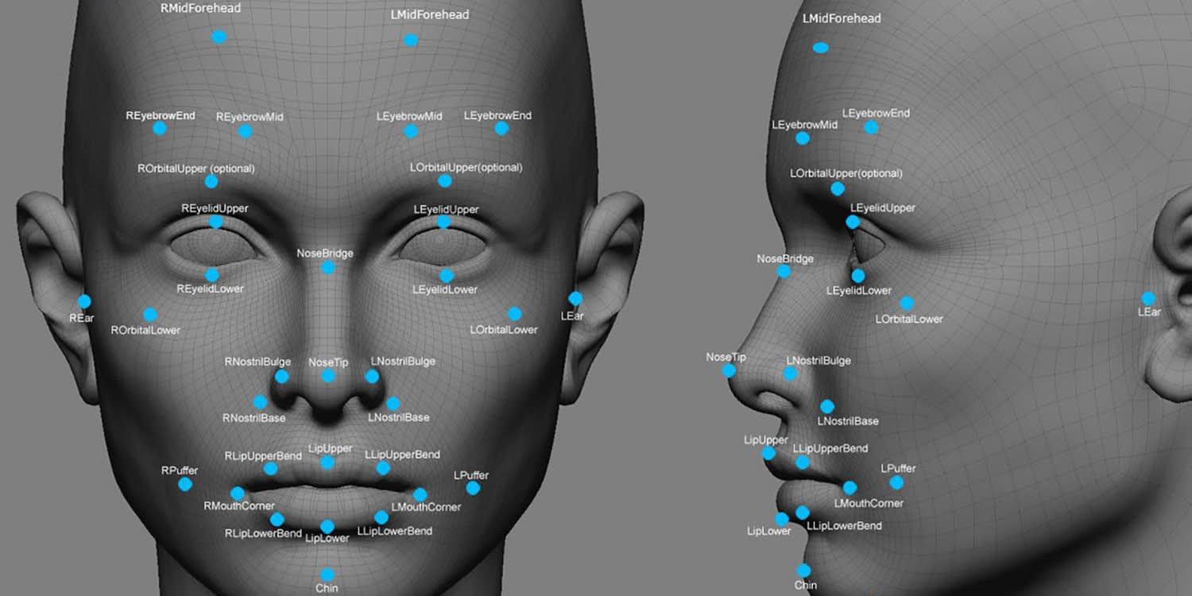
APPROACH 2 ( CO 425 )
Notes:
Thank you sandushi. Lets move into our 2nd approach.

Slide 10
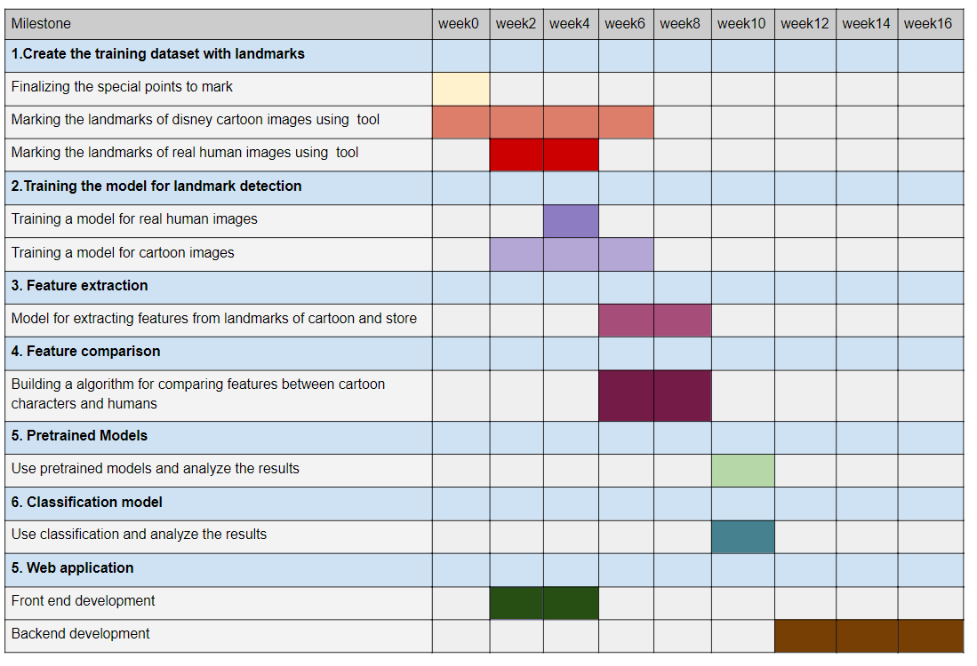
Approach 2 Gantt chart
Notes:
This is the grant chart we created for semster 8.
We planned to complete all the phases within 16 weeks in our second approach.

Slide 11
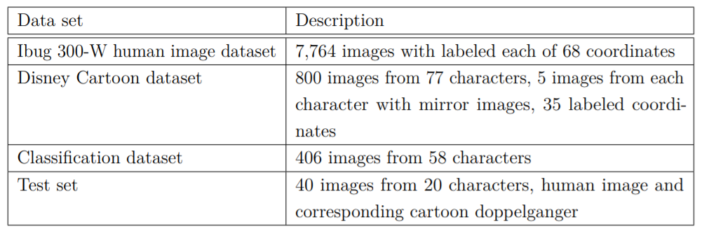
Approach 2
Basic Model - Landmarks based comparison model
To improve the performance
Landmarks based + gender prediction model
Landmarks based + gender prediction + hair extraction model
Classification approach
To compare the results for each model
Rank based comparison
Notes:
Lets have a quick idea about what we have done in approach 2.
In the 2nd approach we mainly focus on building a landmark based comparison model.
First we built the comparison model using only landmarks.
Then by the purpose of improving that model we combined a gender prediction model
and a hair extraction model with the landmark based comaprison model.
Meanwhile we built a classification model for achieving our goal as an alternative
plan.
Finally we did a rank based comparison to find which method works well.
For all the task we used 3 differnet datatsets and one test set.
Then lets see more details about each method.

Slide 12
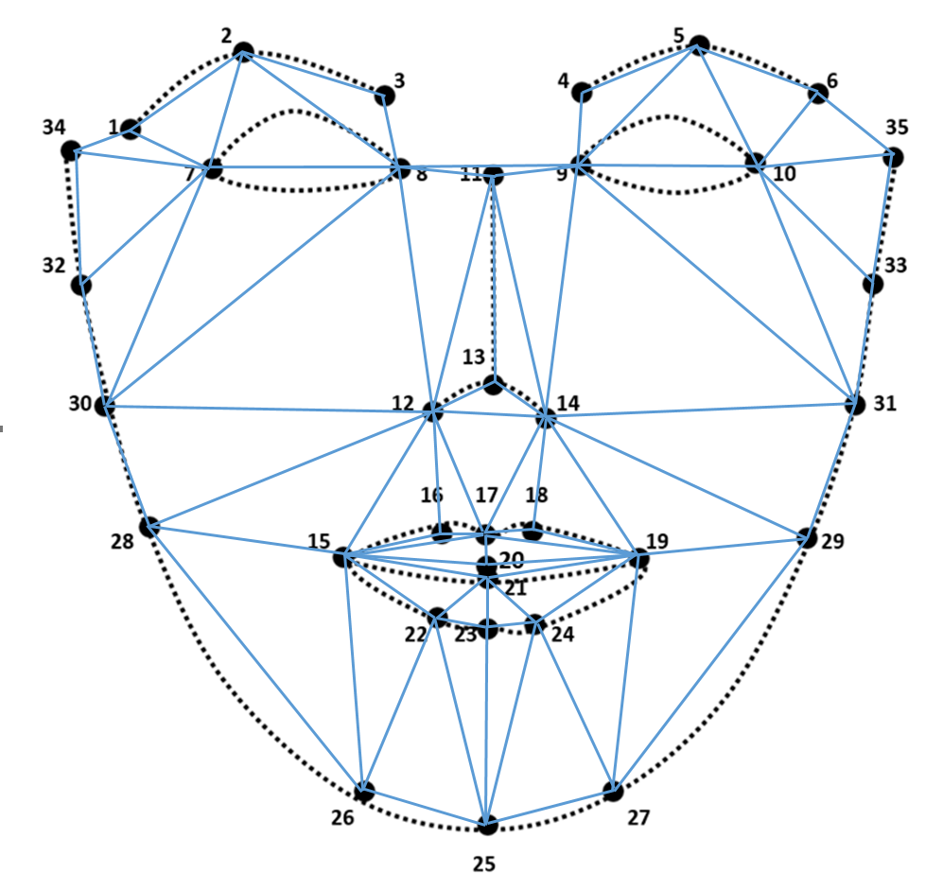
Landmarks based comparison model
Face detection
Dlib frontal face detector
Dlib CNN face detector
Landmarks prediction
Dlib shape predictor model
Feature extraction
Distances
Areas
Feature comparison
Euclidean distance
Notes:
Landmark based comparison model we can divide into 4 parts like face detection,
landmark prediction, feature extraction and feature comaprison.
First we trained two landmark detection models, one for cartoons and other for
humans.
While training the dlib shape predictor landmark detection model we need to detect
faces in human images and cartoon images.
For that we used dlib frontal face detector. .......
Then for all the cartoon images we detected the landmarks points and then
extracted features like distances
and areas betweeen specific points. After that those features were stored in a
csv file.
Then for a new humman image features were extarcted in the same way and they are
compared with the cartoon image features which are stored in the csv file.
For feature camparison euclidean distance was used.

Slide 13
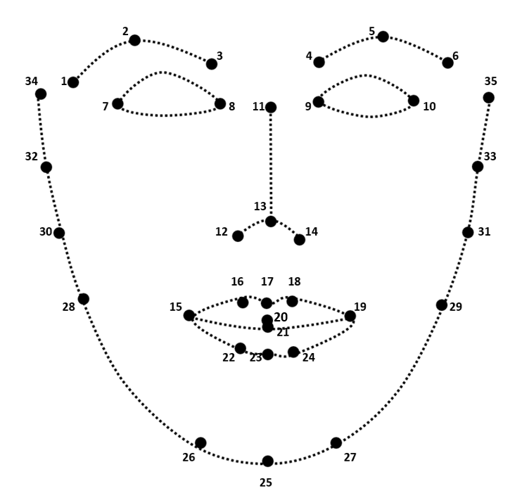
Landmarks based comparison model cont.
Dataset
For human
ibug 300-w dataset → around 3000 images
For cartoon
Own dataset → around 800 disney images
Imglab tool to mark landmarks points
Enlarge dataset
Flip images
35 landmarks on face
dlib’s facial landmark predictor
most common, well-known shape predictor
Notes:
We trained our landmark detection models to detect 35 points on the face.
For training the human landmark prediction model around 3000 images of ibug300w
datatset was used.
For training cartoon landmark prediction model we couldn't find a existing dataset.
Therefore we created that dataset ourselves. It consisted of around 400 disney
images of 77 charaacters at the begining.
We marked 35 points on the each cartoon face using imglab annotating tool.
AFter that for enlarging the dataset we flip all the images and the coordinates
of landmark points.
After that the datatset consitsted of around 800 images.

Slide 14
Landmarks based comparison + Gender prediction model
Landmarks based model comparison
results with both male and female cartoons for a male human image
Model
Trained by Gil Levi and Tal Hassner
Used Adience dataset for training (https://talhassner.github.io/home/projects/Adience/Adience-data.html)
Framed gender prediction as a classification problem
Used the model weight files
Notes:
We identified that in the land mark deection based comparson model some times
we got opposite gender imags as prediction. For a instance for a male human
image we got female cartoon images as predicted doppelganger.
By the purpose of solving this problem we combined a gender prediction model
with our model.
That gender prediction model was trainned by Gil Levi and Tal Hassner.
For training that they have used Adience dataset.
So for our task we didnt train our own model.
We used their weight file for gender prediction on human images.

Slide 15
Landmarks based comparison + Gender prediction + Hair Extraction model
Landmarks-based approach → only the facial features
Similarity not only depends on the face
Hair segmentation
Used a method by ItechyHiker
Used CelebA Face/Hair segmentation database, Figaro, and LFW Part Labels datasets
Our task
Only the shape of hair
Features extracted using VGG16 model
Notes:
Up to now only the face features were considered. But Similarity of a human image
and a cartoon image not depends only on the face, it depends on hair and
the clothes as well.
But considering the colthes is not fair. Therefore we considered hair features.
For hair feature extraction hair segmnetation model which was tranined on
CelebA Face/Hair segmentation database, Figaro, and LFW Part Labels datasets
by ItechyHiker was used.
For our task only the shape of hair was considered. For exatracting hair
features we used VGG16 model.

Slide 16
Landmarks based comparison + Gender prediction + Hair Extraction model cont.
Total euclidean distance
= w∗ Face euclidean distance + (1−w) ∗ Hair euclidean distance
Notes:
In this combined model when calculating the final euclidean distance for
similarity comaparison we multiplied Face euclidean distance with w and
Hair euclidean distance with (1-w) to change how much portion cause to the
final eculidean distance.

Slide 17
Classification model
Image classification is a supervised learning problem
Model
Used TensorFlow 2.0 and Keras
Base model from the MobileNetV2 model
Pre-trained on the ImageNet dataset
Add our classification layer for the Disney cartoons
Dataset - 58 cartoon characters and 406 images
Notes:
AS an alterntive plan we built this image classifiacation model to find the
doppelganager cartoon. Image classification is a supervised learning problem.
WHen buliding the model TensorFlow 2.0 and Keras was used. AS the base model
we used the google MobileNetV2 model. It was a model which was trained on imageNet
dataset.Here our datatset contained 406 images from 58 characteres.
For further cointinuing the presentation i will invite hashan.

Slide 18

RESULTS AND EVALUATION

Slide 19
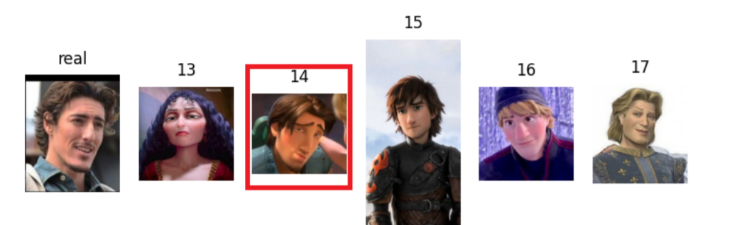
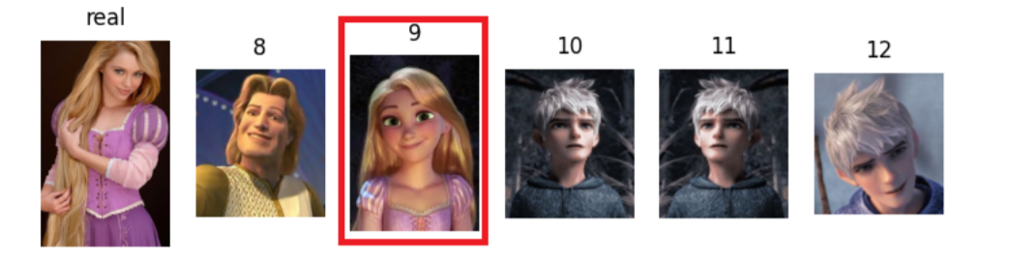
Approach 1(Using pretrained models)

Slide 20
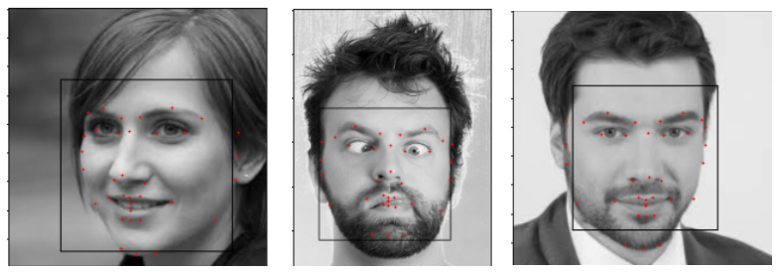
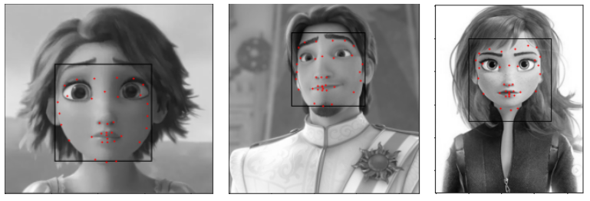
Approach 2 - Landmarks detection
Human
Cartoon

Slide 21
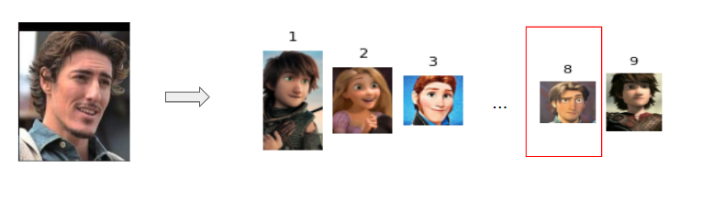
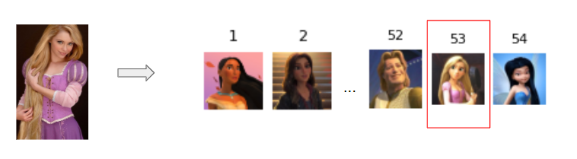
Approach 2 - Landmarks based comparison model

Slide 22
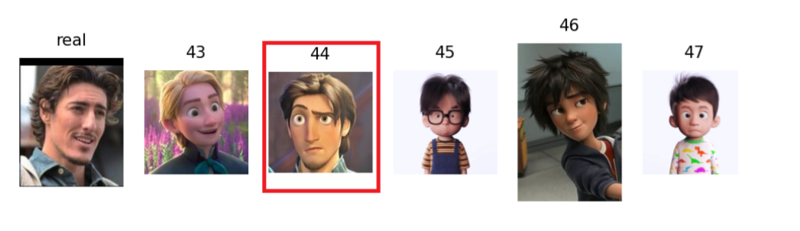
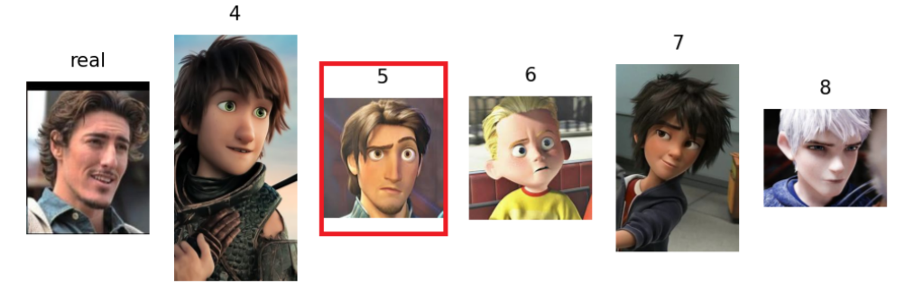
Landmarks based comparison + Gender prediction + Hair Extraction model
W = 0 (hair only)
W = 0.2

Slide 23
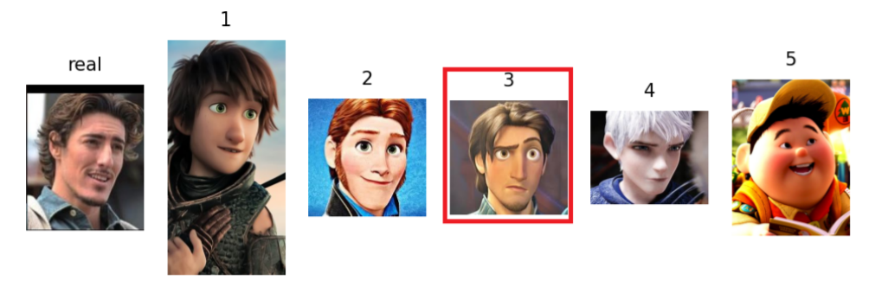
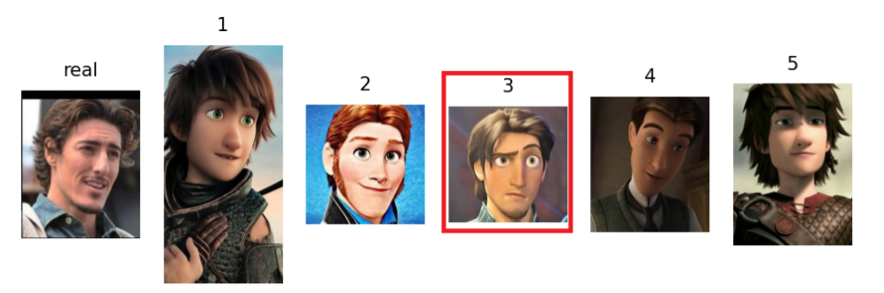
Landmarks based comparison + Gender prediction + Hair Extraction model
W = 0.5
W = 0.8

Slide 25
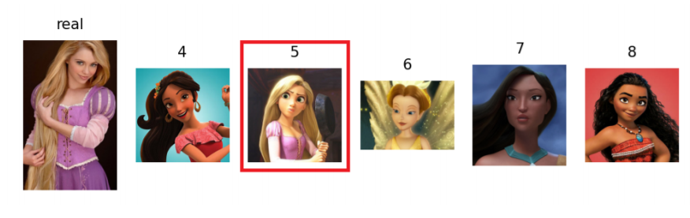
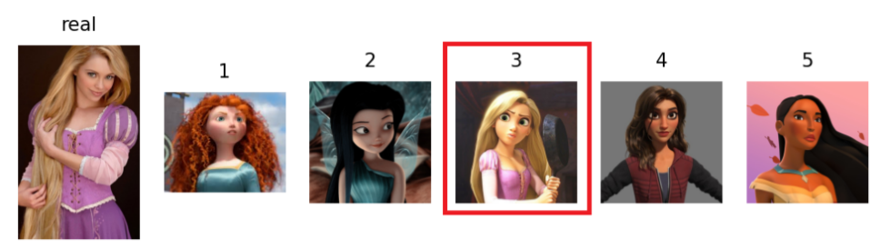
Landmarks based comparison + Gender prediction + Hair Extraction model
W = 0 (hair only)
W = 0.2

Slide 26
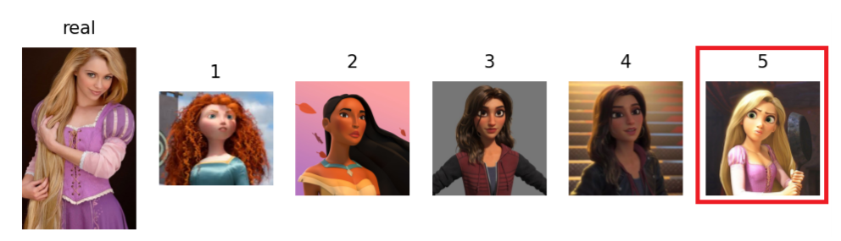
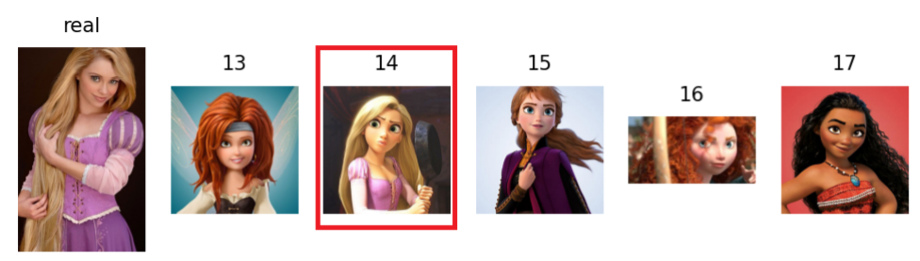
Landmarks based comparison + Gender prediction + Hair Extraction model
W = 0.5
W = 0.8

Slide 27
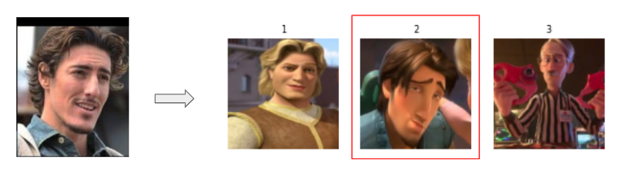
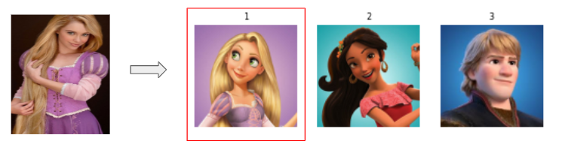
Classification

Slide 28
Analysis
Used Landmarks based model
Approach 2 - Landmarks based
Face detection - problems in angled cartoon images
Comparison - not good results , only face is considered ,have male and female results for male images
Approach 1
Human face - 100%
Cartoon face - 40%
Add gender prediction model
Approach 2 - Landmarks + Gender + Hair
Improves the performance
Ranks are different for different weights
Add Hair extraction model
Approach 2 - Landmarks + gender
Results are with only corresponding gender
Classification
Gives better results within top 3 ranks

Slide 29
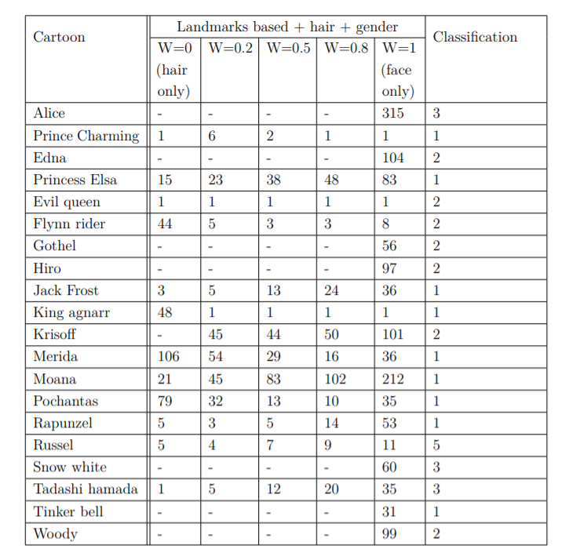
Overall Analysis
Rank based comparison
Test all models for 20 images

Slide 30
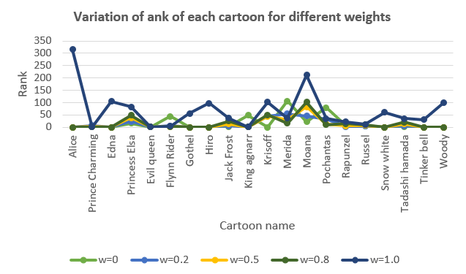
Overall Analysis cont.
Variation of rank of each cartoon for different weights
Models do not give an output / rank
Failures of hair extraction or gender prediction models
Rank varies for different weights
Some cartoons get better rank in w = 0.5
Some Cartoons get better at w=0.2
w=1 (landmarks-based model only) always gives higher ranks (far away from expected result)
w=0.2 and w=0.5 (combined model) gives some good ranks for all cartoons
Classification model gives the best results within the top 5 ranks.

Slide 31
Conclusion
Combined model has improved the performance
But the best cartoon image is resulted for different weights on the models for various images
Strong dataset can improve the results of combined model
Classification model gives the better results
84% accuracy on training data and 80% accuracy on validation after 100 epochs

Slide 32

Future Works
Get real usage of our model
By completing the backend of the web application
Build a cartoon face detection model from scratch
Improve the performance of finding doppelganger by considering the whole body

Slide 33


Slide 34

THANK YOU!
Supervisors :
Dr. Asitha Bandaranayake
Mr. Sampath Deegalla
Mr. Ishan Gammanpila
Group members :
E/15/065 De Silva K.G.P.M.
E/15/076 Dileka J.H.S.
E/15/220 Maliththa K.H.H.

